Slide 1
Describing Logic Circuit-I

Slide 2
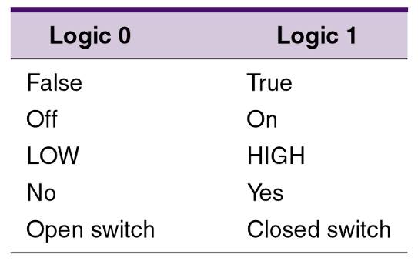
3-1 Boolean Constants and Variables
Boolean algebra allows only two values—0 and 1.
Logic 0 can be: false, off, low, no, open switch.
Logic 1 can be: true, on, high, yes, closed switch.
The three basic logic operations:
OR, AND, and NOT.

Slide 3
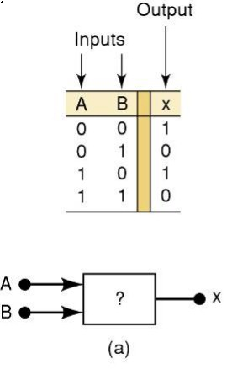
3-2 Truth Tables
A truth table describes the relationship between the input and output of a logic circuit.
The number of entries corresponds to the number of inputs.
A 2-input table would have 2² = 4 entries.
A 3-input table would have 2³ = 8 entries.

Slide 4
3-3 OR Operation With OR Gates
Boolean expression for the OR operation is:
X = A + B — Read as “X equals A OR B”
The + sign does not stand for ordinary addition—it stands for the OR operation
The OR operation is similar to addition, but when A = 1 and B = 1, the OR operation produces:
1 + 1 = 1 not 1 + 1 = 2
In the Boolean expression x = 1 + 1 + 1 = 1…
x is true (1) when A is true (1) OR B is true (1) OR C is true (1)

Slide 5
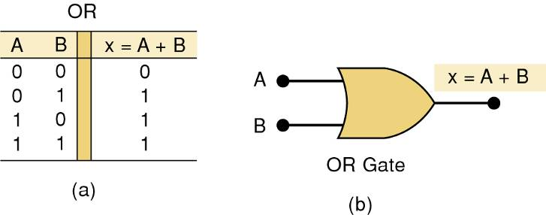
3-3 OR Operation With OR Gates
An OR gate is a circuit with two or more inputs, whose output is equal to the OR combination of the inputs.
Truth table/circuit symbol for a two input OR gate.

Slide 6
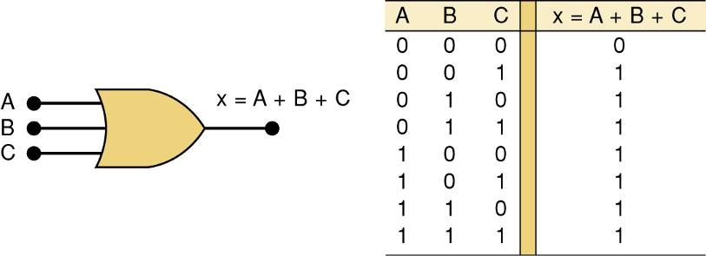
3-3 OR Operation With OR Gates
An OR gate is a circuit with two or more inputs, whose output is equal to the OR combination of the inputs.
Truth table/circuit symbol for a three input OR gate.

Slide 7
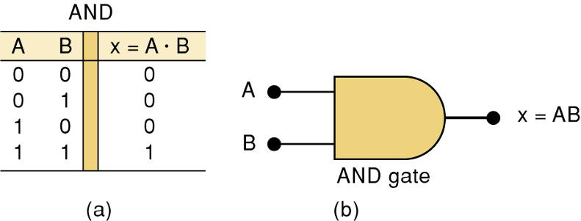
3-4 AND Operations with AND gates
The AND operation is similar to multiplication:
X = A • B • C — Read as “X equals A AND B AND C”
The . sign does not stand for ordinary multiplication—it stands for the AND operation.
x is true (1) when A AND B AND C are true (1)
Truth table — Gate symbol.

Slide 8
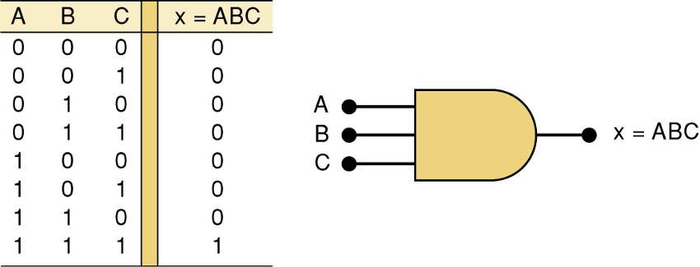
3-4 AND Operations with AND gates
Truth table/circuit symbol for a three input AND gate.

Slide 9
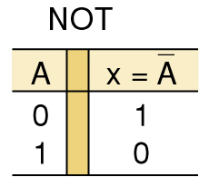
3-5 NOT Operation(The Boolean expression for the NOT operation):
X = A
— Read as:
“X equals NOT A”
“X equals the inverse of A”
“X equals the complement of A”
The overbear represents the NOT operation.
A' = A
Another indicator for inversion is the prime symbol (').
NOT Truth Table

Slide 10
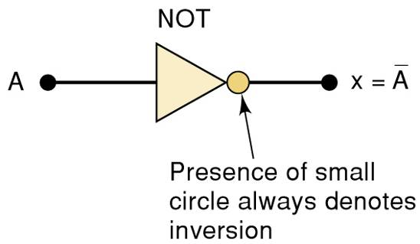
3-5 NOT Operation
A NOT circuit—commonly called an INVERTER.
This circuit always has only a single input, and the out-put logic level is always opposite to the logic level of this input.

Slide 11
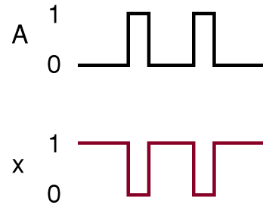
3-5 NOT Operation
The INVERTER inverts (complements) the input signal at all points on the waveform.
Whenever the input = 0, output = 1, and vice versa.

Slide 12
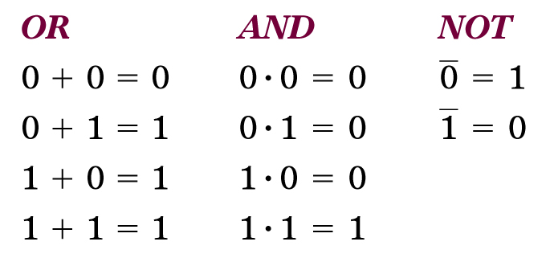
Boolean Operations
Summarized rules for OR, AND and NOT
These three basic Boolean operations can describe any logic circuit.

Slide 13
Order of Precedence of logical operators
From highest to lowest-
Not
parenthesis
And
OR

Slide 14
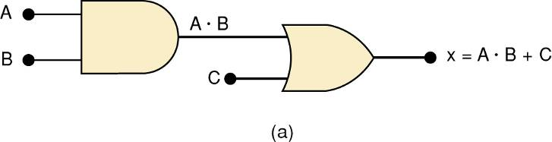
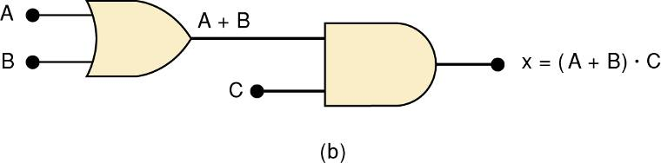
Describing Logic Circuits Algebraically
If an expression contains both AND and OR gates, the AND operation will be performed first.
Unless there is a parenthesis in the expression.

Slide 15
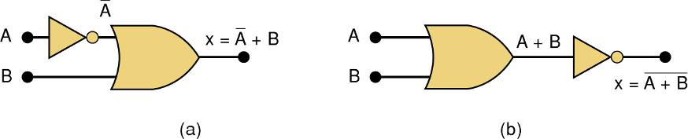
3-6 Describing Logic Circuits Algebraically
Whenever an INVERTER is present, output is equivalent to input, with a bar over it.
Input A through an inverter equals A.

Slide 16
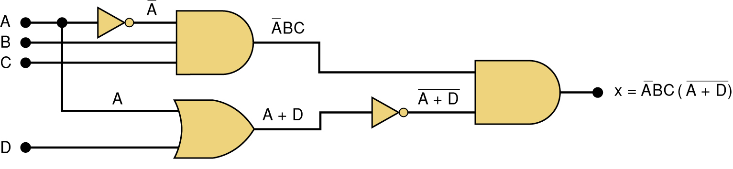
3-6 Describing Logic Circuits Algebraically
Further examples…

Slide 17
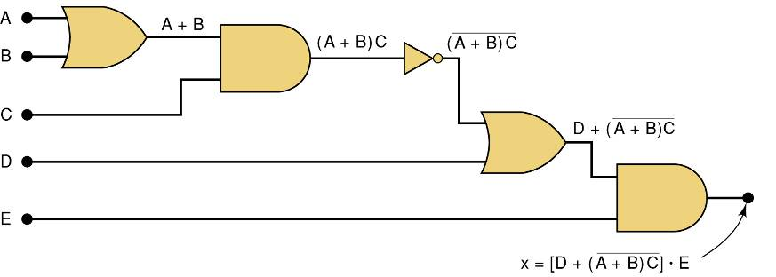
3-6 Describing Logic Circuits Algebraically
Further examples…

Slide 18
3-7 Evaluating Logic Circuit Outputs
Rules for evaluating a Boolean expression:
Perform all inversions of single terms.
Perform all operations within parenthesis.
Perform AND operation before an OR operation unless parenthesis indicate otherwise.
If an expression has a bar over it, perform operations inside the expression, and then invert the result.

Slide 19
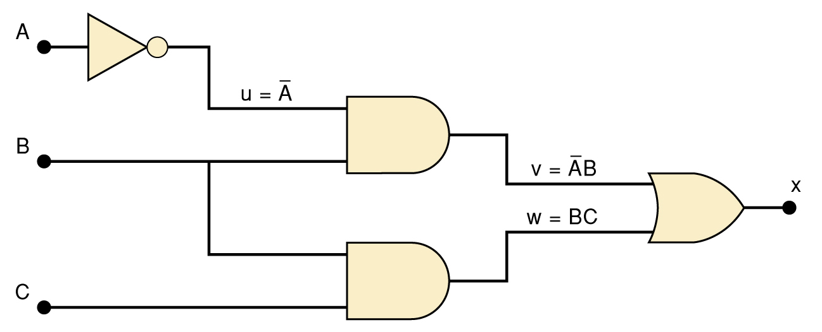
3-7 Evaluating Logic Circuit Outputs
The best way to analyze a circuit made up of multiple logic gates is to use a truth table.
It allows you to analyze one gate or logic combination at a time.
It allows you to easily double-check your work.
When you are done, you have a table of tremendous benefit in troubleshooting the logic circuit.

Slide 20
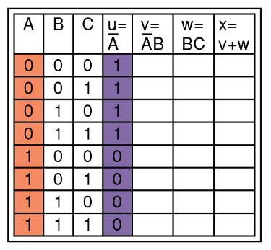
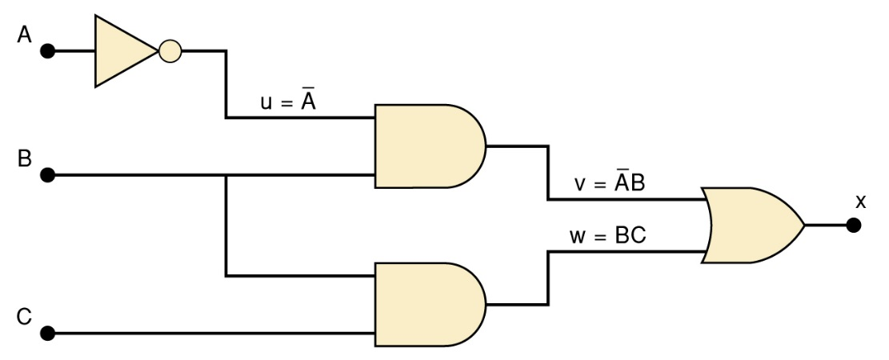
3-7 Evaluating Logic Circuit Outputs
The first step after listing all input combinations is to create a column in the truth table for each intermediate signal (node).
Node u has been filled as the complement of A

Slide 21
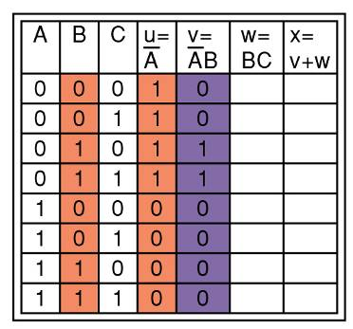
3-7 Evaluating Logic Circuit Outputs
The next step is to fill in the values for column v.
v =AB — Node v should be HIGH when A (node u) is HIGH AND B is HIGH

Slide 22
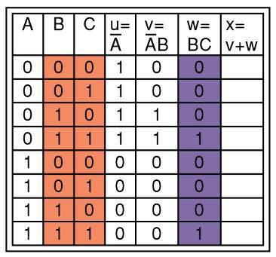
3-7 Evaluating Logic Circuit Outputs
The third step is to predict the values at node w which is the logical product of BC.
This column is HIGH whenever B is HIGH AND C is HIGH

Slide 23
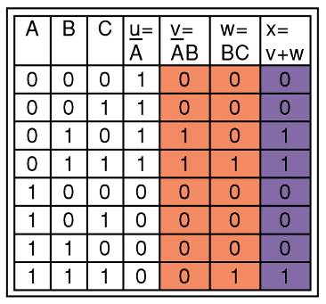
3-7 Evaluating Logic Circuit Outputs
The final step is to logically combine columns v and w to predict the output x.
Since x = v + w, the x output will be HIGH when v OR w is HIGH

Slide 24
3-7 Evaluating Logic Circuit Outputs
Output logic levels can be determined directly from a circuit diagram.
Output of each gate is noted until final output is found.

Slide 25
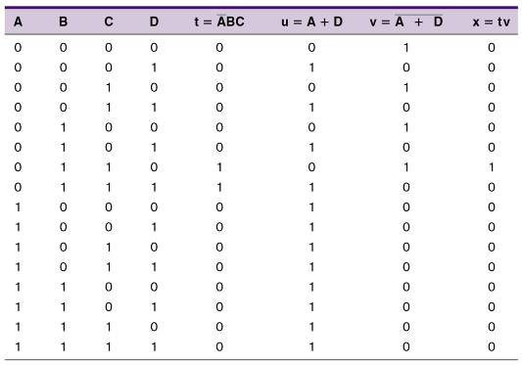
3-7 Evaluating Logic Circuit Outputs
Table of logic state at each node of the circuit shown.

Slide 26
3-8 Implementing Circuits From Boolean Expressions
It is important to be able to draw a logic circuit from a Boolean expression.
The expression X = A • B • C, could be drawn as a three input AND gate.
A circuit defined by X = A + B, would use a two-input OR gate with an INVERTER on one of the inputs.

Slide 27
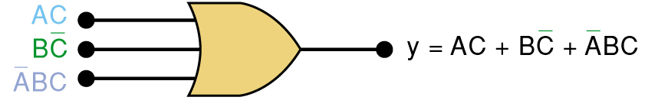
3-8 Implementing Circuits From Boolean Expressions
A circuit with output y = AC + BC + ABC contains three terms which are ORed together.
…and requires a three-input OR gate.

Slide 28
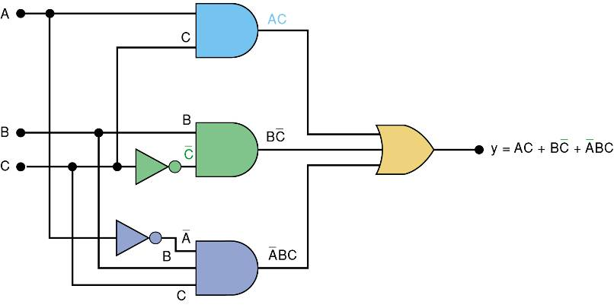
3-8 Implementing Circuits From Boolean Expressions
Each OR gate input is an AND product term,
An AND gate with appropriate inputs can be used to generate each of these terms.

Slide 29
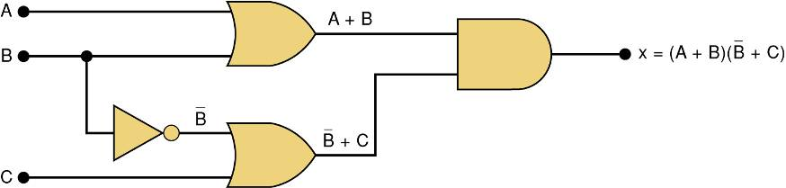
3-8 Implementing Circuits From Boolean Expressions
Circuit diagram to implement x = (A + B) (B + C)

